Slide 1
Chapter 3
Structured Query Language: Creating and manipulating data

Slide 2
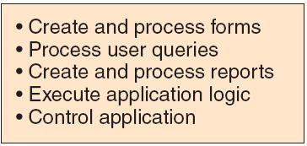
In chapter 1, we looked at how databases are used in various business applications

Slide 3

In chapter 2, we see how databases are helpful in decision making

Slide 4
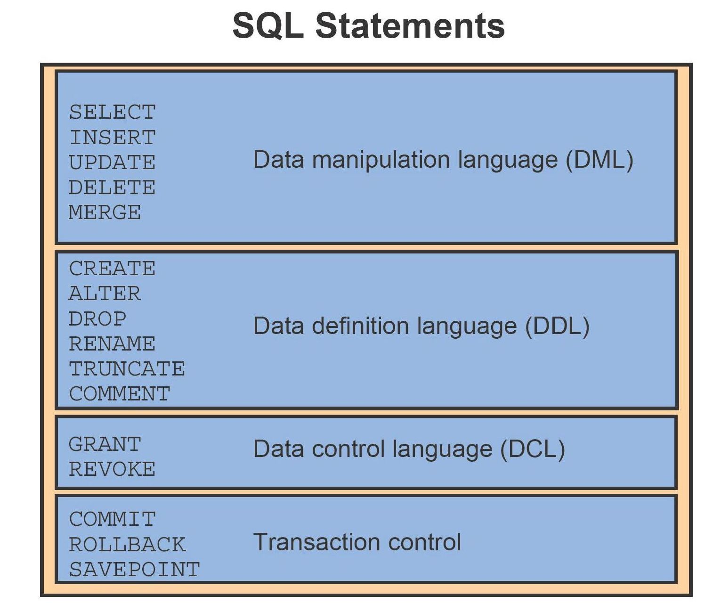
In this chapter, we learn how to create, load data and extract information from a database
This is accomplish using Structured Query Language (SQL)

Slide 5
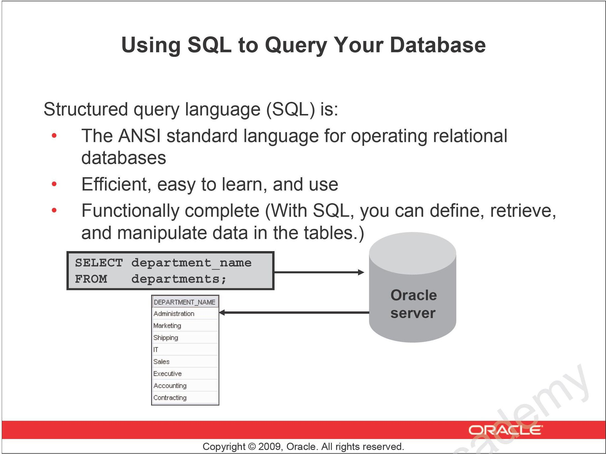

Slide 6
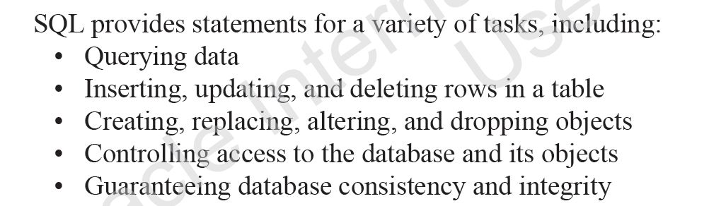
SQL unifies all the preceding tasks in one consistent language that enables you to work with data at a logical level.

Slide 7
The HR Entity Relationship Diagram
HR
DEPARTMENTS
department_id
department_name
manager_id
location_id
LOCATIONS
location_id
street_address
postal_code
city
state_province
country_id
JOB_HISTORY employee_id
start_date
end_date
job_id
department_id
EMPLOYEES
employee_id
first_name
last_name
email
phone_number
hire_date
job_id
salary
commission_pct
manager_id
department_id
COUNTRIES
country_id
country_name
region_id
JOBS job_id
job_title
min_salary
max_salary
REGIONS
region_id
region_name

Slide 8

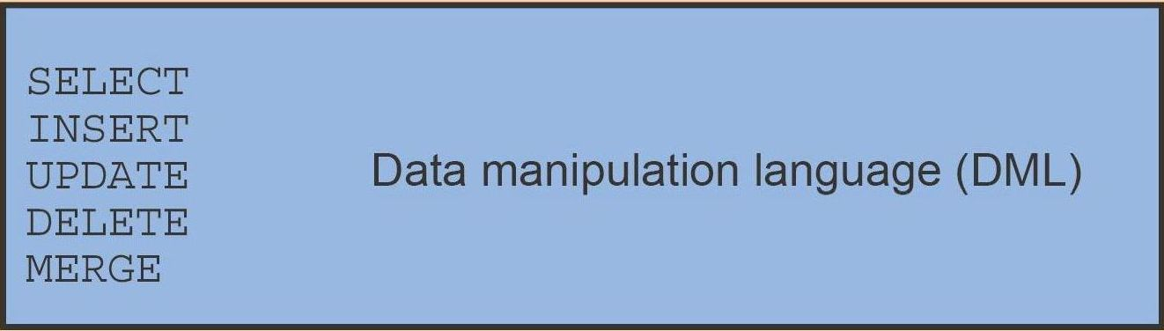
To create the database tables, we will use DDL statements
First, we will create the table structure according to a specific design in order to store data.
Second, we will put some data into the tables

Slide 9
Table: REGIONS
attributes | datatype | max size | Remarks
region_id | numeric | 2 | identification code for each region
region_name | string | 25 | name of the region
Define the table structure for data storage
CREATE TABLE regions
(region_id NUMBER(2) NOT NULL,
region_name VARCHAR(25),
PRIMARY KEY(region_id)
);
Input data into the table:
INSERT INTO regions VALUES ( 1, 'Europe');
INSERT INTO regions VALUES ( 2, 'Americas');
INSERT INTO regions VALUES ( 3, 'Asia');
INSERT INTO regions VALUES ( 4, 'Middle East and Africa');

Slide 10
Define the table structure for data storage
The CREATE TABLE statement :
CREATE TABLE <name of table>
( attribute-1 datatype(size) Constraints,
attribute-2 datatype(size) Constraints,
.
.
.
attribute-N datatype(size) Constraints,
PRIMARY KEY (attribute name, . . ., attribute name)
);
Input data into the table:
The INSERT INTO statement :
INSERT INTO name of table VALUES
(item-1, item-2,. . . , item-N);

Slide 11
Table: COUNTRIES
attributes | datatype | max size | Remarks
country_id | char | 2 | fixed 2-character code for each country
country_name | string | 40 | name of the country
region_id | numeric | 2 | region where the country is in
CREATE TABLE countries
( country_id CHAR(2) NOT NULL ,
country_name VARCHAR(40),
region_id NUMBER,
PRIMARY KEY (country_id)
) ;
INSERT INTO countries VALUES('IT','Italy', 1);
INSERT INTO countries VALUES('JP','Japan', 3);
INSERT INTO countries VALUES('US','United States of America', 2);
INSERT INTO countries VALUES('CA','Canada', 2);
INSERT INTO countries VALUES('CN','China', 3);
INSERT INTO countries VALUES('IN','India', 3);
INSERT INTO countries VALUES('AU','Australia', 3);
INSERT INTO countries VALUES('ZW','Zimbabwe', 4);
. . . and many more records . . .

Slide 12
Table: LOCATIONS
attributes | datatype | max size | Remarks
location_id | numeric | 4 | identification code for each location
street_address | string | 40
postal_code | string | 30
city | string | 30
state_province | string | 25
country_id | char | 2 | fixed 2-character code for each country
CREATE TABLE locations
( location_id NUMBER(4),
street_address VARCHAR(40),
postal_code VARCHAR(12),
city VARCHAR(30) NOT NULL,
state_province VARCHAR(25),
country_id CHAR(2),
PRIMARY KEY (location_id)
);
INSERT INTO locations VALUES (1000, '1297 Via Cola di Rie', '00989', 'Roma', NULL, 'IT');
INSERT INTO locations VALUES (1100, '93091 Calle della Testa', '10934', 'Venice', NULL, 'IT');
INSERT INTO locations VALUES (1200, '2017 Shinjuku-ku', '1689', 'Tokyo', 'Tokyo Prefecture', 'JP');
INSERT INTO locations VALUES (1300, '9450 Kamiya-cho', '6823', 'Hiroshima', NULL, 'JP');
INSERT INTO locations VALUES (1400, '2014 Jabberwocky Rd', '26192', 'Southlake', 'Texas', 'US');

Slide 13
Table: DEPARTMENTS
attributes | datatype | max size | Remarks
department_id | numeric | 2 | identification code for each department
department_name | string | 25
manager_id | numeric | 6
location_id | numeric | 4 | identification code for each location
CREATE TABLE departments
( department_id NUMBER(4),
department_name VARCHAR(30) NOT NULL,
manager_id NUMBER(6),
location_id NUMBER(4),
PRIMARY KEY (department_id)
);
INSERT INTO departments VALUES ( 10, 'Administration', 200, 1700);
INSERT INTO departments VALUES ( 20, 'Marketing', 201, 1800);
INSERT INTO departments VALUES ( 30, 'Purchasing', 114, 1700);
INSERT INTO departments VALUES ( 40, 'Human Resources', 203, 2400);
INSERT INTO departments VALUES ( 50, 'Shipping', 121, 1500);
INSERT INTO departments VALUES ( 60 , 'IT', 103, 1400);
INSERT INTO departments VALUES ( 70 , 'Public Relations', 204, 2700);
INSERT INTO departments VALUES ( 80 , 'Sales', 145, 2500);
INSERT INTO departments VALUES ( 90 , 'Executive', 100, 1700);

Slide 14
Table: JOBS
attributes | datatype | max size | Remarks
job_id | string | 10 | identification code for each job
job_title | string | 25
min_salary | numeric | 6 | integer number that represents minimum salary
max_salary | numeric | 6 | integer number that represents maximum salary
CREATE TABLE jobs
( job_id VARCHAR(10),
job_title VARCHAR(35) NOT NULL,
min_salary NUMBER(6),
max_salary NUMBER(6),
PRIMARY KEY (job_id)
);
INSERT INTO jobs VALUES ( 'AD_PRES', 'President', 20000, 40000);
INSERT INTO jobs VALUES ( 'AD_VP', 'Administration Vice President', 15000, 30000);
INSERT INTO jobs VALUES ( 'AD_ASST', 'Administration Assistant', 3000, 6000);
INSERT INTO jobs VALUES ( 'FI_MGR', 'Finance Manager', 8200, 16000);
INSERT INTO jobs VALUES ( 'FI_ACCOUNT', 'Accountant', 4200, 9000);
INSERT INTO jobs VALUES ( 'AC_MGR', 'Accounting Manager', 8200, 16000);
INSERT INTO jobs VALUES ( 'AC_ACCOUNT', 'Public Accountant', 4200, 9000);
INSERT INTO jobs VALUES ( 'SA_MAN', 'Sales Manager', 10000, 20000);
INSERT INTO jobs VALUES ( 'SA_REP', 'Sales Representative', 6000, 12000);

Slide 15
Table: EMPLOYEES
attributes | datatype | max size | Remarks
employee_id | numeric | 6 | identification code for each employee
first_name | string | 20 | name of the region
last_name | string | 25
email | string | 25
phone_number | string | 20
hire_date | date
job_id | string | 10 | identification code for each job
salary | numeric | 999,999.99
commission_pct | numeric | 99.99
manager_id | numeric | 6
department_id | numeric | 2 digits | identification code for each department
CREATE TABLE employees
( employee_id NUMBER(6),
first_name VARCHAR(20),
last_name VARCHAR(25) NOT NULL,
email VARCHAR(25) NOT NULL UNIQUE,
phone_number VARCHAR(20),
hire_date DATE NOT NULL,
job_id VARCHAR(10) NOT NULL,
salary NUMBER(8,2),
commission_pct NUMBER(2,2),
manager_id NUMBER(6),
department_id NUMBER(4),
PRIMARY KEY (employee_id)
);

Slide 16
Input data into EMPLOYEES the table:
INSERT INTO employees
VALUES ( 100, 'Steven', 'King', 'SKING', '515.123.4567',
TO_DATE('17-JUN-1987', 'dd-MON-yyyy'), 'AD_PRES', 24000, NULL, NULL, 90);
INSERT INTO employees
VALUES ( 101, 'Neena', 'Kochhar', 'NKOCHHAR', '515.123.4568',
TO_DATE('21-SEP-1989', 'dd-MON-yyyy'), 'AD_VP', 17000, NULL, 100, 90);
INSERT INTO employees
VALUES ( 102, 'Lex', 'De Haan', 'LDEHAAN', '515.123.4569',
TO_DATE('13-JAN-1993', 'dd-MON-yyyy'), 'AD_VP', 17000, NULL, 100, 90);
INSERT INTO employees
VALUES ( 103, 'Alexander', 'Hunold', 'AHUNOLD', '590.423.4567',
TO_DATE('03-JAN-1990', 'dd-MON-yyyy'), 'IT_PROG', 9000, NULL, 102, 60);

Slide 17
Table: JOB_HISTORY
attributes | datatype | max size | Remarks
employee_id | numeric | 6 | identification code for each employee
start_date | date
end_date | date
job_id | string | 10 | identification code for each job
department_id | numeric | 2 digits | identification code for each department
CREATE TABLE job_history
( employee_id NUMBER(6) NOT NULL,
start_date DATE NOT NULL,
end_date DATE NOT NULL,
job_id VARCHAR(10) NOT NULL,
department_id NUMBER(4),
PRIMARY KEY (employee_id,start_date)
);
INSERT INTO job_history VALUES (102, TO_DATE('13-JAN-1993', 'dd-MON-yyyy'),
TO_DATE('24-JUL-1998', 'dd-MON-yyyy'), 'IT_PROG', 60);
INSERT INTO job_history VALUES (101, TO_DATE('21-SEP-1989', 'dd-MON-yyyy'),
TO_DATE('27-OCT-1993', 'dd-MON-yyyy'), 'AC_ACCOUNT', 110);
INSERT INTO job_history VALUES (101, TO_DATE('28-OCT-1993', 'dd-MON-yyyy'),
TO_DATE('15-MAR-1997', 'dd-MON-yyyy'), 'AC_MGR', 110);
INSERT INTO job_history VALUES (201, TO_DATE('17-FEB-1996', 'dd-MON-yyyy'),
TO_DATE('19-DEC-1999', 'dd-MON-yyyy'), 'MK_REP', 20);

Slide 18
Retrieving Data Using the SQL SELECT Statement

Slide 19
Capabilities of SQL SELECT Statements
Projection
Selection
Table 1
Table 1
Join
Table 1
Table 2
Notes:
Capabilities of SQL SELECT Statements
A SELECT statement retrieves information from the database. With a SELECT statement, you can use the following capabilities:
Projection: Select the columns in a table that are returned by a query. Select as few or as many of the columns as required.
Selection: Select the rows in a table that are returned by a query. Various criteria can be used to restrict the rows that are retrieved.
Joining: Bring together data that is stored in different tables by specifying the link between them. SQL joins are covered in more detail in the lesson titled “Displaying Data from Multiple Tables.”

Slide 20
Basic SELECT Statement
SELECT *|{[DISTINCT] column|expression [alias],...}
FROM table;
SELECT identifies the columns to be displayed.
FROM identifies the table containing those columns.
Notes:
Basic SELECT Statement
In its simplest form, a SELECT statement must include the following:
A SELECT clause, which specifies the columns to be displayed
A FROM clause, which identifies the table containing the columns that are listed in the SELECT clause
In the syntax:
SELECT is a list of one or more columns
* selects all columns
DISTINCT suppresses duplicates
column|expression selects the named column or the expression
alias gives the selected columns different headings
FROM table specifies the table containing the columns
Note: Throughout this course, the words keyword, clause, and statement are used as follows:
A keyword refers to an individual SQL element. For example, SELECT and FROM are keywords.
A clause is a part of a SQL statement. For example, SELECT employee_id, last_name, and so on is a clause.
A statement is a combination of two or more clauses. For example, SELECT * FROM employees is a SQL statement.

Slide 21
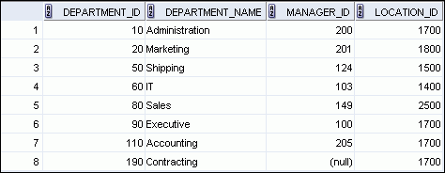
Selecting All Columns
SELECT *
FROM departments;
Indicative row number
Notes:
Selecting All Columns
You can display all columns of data in a table by following the SELECT keyword with an asterisk (*). In the example in the slide, the department table contains four columns: DEPARTMENT_ID, DEPARTMENT_NAME, MANAGER_ID, and LOCATION_ID. The table contains eight rows, one for each department.
You can also display all columns in the table by listing all the columns after the SELECT keyword. For example, the following SQL statement (like the example in the slide) displays all columns and all rows of the DEPARTMENTS table:
SELECT department_id, department_name, manager_id, location_id FROM departments;
Note: In SQL Developer, you can enter your SQL statement in a SQL Worksheet and click the “Execute Statement” icon or press [F9] to execute the statement. The output displayed in the Results tabbed page appears as shown in the slide.

Slide 22
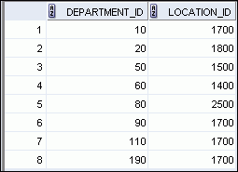
Selecting Specific Columns
SELECT department_id, location_id
FROM departments;
Notes:
Selecting Specific Columns
You can use the SELECT statement to display specific columns of the table by specifying the column names, separated by commas. The example in the slide displays all the department numbers and location numbers from the DEPARTMENTS table.
In the SELECT clause, specify the columns that you want in the order in which you want them to appear in the output. For example, to display location before department number (from left to right), you use the following statement:
SELECT location_id, department_id
FROM departments;
…

Slide 23
Arithmetic Expressions
Create expressions with number and date data by using arithmetic operators.
Operator
Description
+
Add
-
Subtract
*
Multiply
/
Divide
Notes:
Arithmetic Expressions
You may need to modify the way in which data is displayed, or you may want to perform calculations, or look at what-if scenarios. All these are possible using arithmetic expressions. An arithmetic expression can contain column names, constant numeric values, and the arithmetic operators.
Arithmetic Operators
The slide lists the arithmetic operators that are available in SQL. You can use arithmetic operators in any clause of a SQL statement (except the FROM clause).
Note: With the DATE and TIMESTAMP data types, you can use the addition and subtraction operators only.

Slide 24
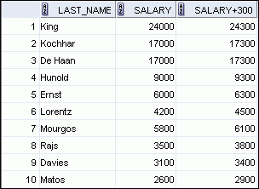
Using Arithmetic Operators
SELECT last_name, salary, salary + 300
FROM employees;
…
Notes:
Using Arithmetic Operators
The example in the slide uses the addition operator to calculate a salary increase of $300 for all employees. The slide also displays a SALARY+300 column in the output.
Note that the resultant calculated column, SALARY+300, is not a new column in the EMPLOYEES table; it is for display only. By default, the name of a new column comes from the calculation that generated it—in this case, salary+300.
Note: The Oracle server ignores blank spaces before and after the arithmetic operator.
Operator Precedence
If an arithmetic expression contains more than one operator, multiplication and division are evaluated first. If operators in an expression are of the same priority, then evaluation is done from left to right.
You can use parentheses to force the expression that is enclosed by the parentheses to be evaluated first.
Rules of Precedence:
Multiplication and division occur before addition and subtraction.
Operators of the same priority are evaluated from left to right.
Parentheses are used to override the default precedence or to clarify the statement.

Slide 25


Operator Precedence
SELECT last_name, salary, 12*salary+100
FROM employees;
1
…
SELECT last_name, salary, 12*(salary+100)
FROM employees;
2
…
Notes:
Operator Precedence (continued)
The first example in the slide displays the last name, salary, and annual compensation of employees. It calculates the annual compensation by multiplying the monthly salary with 12, plus a one-time bonus of $100. Note that multiplication is performed before addition.
Note: Use parentheses to reinforce the standard order of precedence and to improve clarity. For example, the expression in the slide can be written as (12*salary)+100 with no change in the result.
Using Parentheses
You can override the rules of precedence by using parentheses to specify the desired order in which the operators are to be executed.
The second example in the slide displays the last name, salary, and annual compensation of employees. It calculates the annual compensation as follows: adding a monthly bonus of $100 to the monthly salary, and then multiplying that subtotal with 12. Because of the parentheses, addition takes priority over multiplication.

Slide 26



Defining a Null Value
Null is a value that is unavailable, unassigned, unknown, or inapplicable.
Null is not the same as zero or a blank space.
SELECT last_name, job_id, salary, commission_pct
FROM employees;
…
…
Notes:
Defining a Null Value
If a row lacks a data value for a particular column, that value is said to be null or to contain a null.
Null is a value that is unavailable, unassigned, unknown, or inapplicable. Null is not the same as zero or a blank space. Zero is a number and blank space is a character.
Columns of any data type can contain nulls. However, some constraints (NOT NULL and PRIMARY KEY) prevent nulls from being used in the column.
In the COMMISSION_PCT column in the EMPLOYEES table, notice that only a sales manager or sales representative can earn a commission. Other employees are not entitled to earn commissions. A null represents that fact.
Note: By default, SQL Developer uses the literal, (null), to identify null values. However, you can set it to something more relevant to you. To do so, select Preferences from the Tools menu. In the Preferences dialog box, expand the Database node. Click Advanced Parameters and on the right pane, for the “Display Null value As,” enter the appropriate value.

Slide 27



Null Values in Arithmetic Expressions
Arithmetic expressions containing a null value evaluate to null.
SELECT last_name, 12*salary*commission_pct
FROM employees;
…
…
Notes:
Null Values in Arithmetic Expressions
If any column value in an arithmetic expression is null, the result is null. For example, if you attempt to perform division by zero, you get an error. However, if you divide a number by null, the result is a null or unknown.
In the example in the slide, employee King does not get any commission. Because the COMMISSION_PCT column in the arithmetic expression is null, the result is null.
For more information, see the section on “Basic Elements of Oracle SQL” in Oracle Database SQL Language Reference 11g, Release 1 (11.1).

Slide 28
Defining a Column Alias
A column alias:
Renames a column heading
Is useful with calculations
Immediately follows the column name (There can also be the optional AS keyword between the column name and alias.)
Requires double quotation marks if it contains spaces or special characters, or if it is case-sensitive
Notes:
Defining a Column Alias
When displaying the result of a query, SQL Developer normally uses the name of the selected column as the column heading. This heading may not be descriptive and, therefore, may be difficult to understand. You can change a column heading by using a column alias.
Specify the alias after the column in the SELECT list using blank space as a separator. By default, alias headings appear in uppercase. If the alias contains spaces or special characters (such as # or $), or if it is case-sensitive, enclose the alias in double quotation marks (“ ”).

Slide 29


Using Column Aliases
SELECT last_name AS name, commission_pct comm
FROM employees;
SELECT last_name "Name" , salary*12 "Annual Salary"
FROM employees;
…
Notes:
Using Column Aliases
The first example displays the names and the commission percentages of all the employees. Note that the optional AS keyword has been used before the column alias name. The result of the query is the same whether the AS keyword is used or not. Also, note that the SQL statement has the column aliases, name and comm, in lowercase, whereas the result of the query displays the column headings in uppercase. As mentioned in the previous slide, column headings appear in uppercase by default.
The second example displays the last names and annual salaries of all the employees. Because Annual Salary contains a space, it has been enclosed in double quotation marks. Note that the column heading in the output is exactly the same as the column alias.

Slide 30
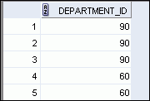
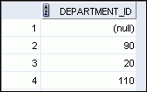
Duplicate Rows
The default display of queries is all rows, including duplicate rows.
SELECT department_id
FROM employees;
1
…
SELECT DISTINCT department_id
FROM employees;
2
…
Notes:
Duplicate Rows
Unless you indicate otherwise, SQL displays the results of a query without eliminating the duplicate rows. The first example in the slide displays all the department numbers from the EMPLOYEES table. Note that the department numbers are repeated.
To eliminate duplicate rows in the result, include the DISTINCT keyword in the SELECT clause immediately after the SELECT keyword. In the second example in the slide, the EMPLOYEES table actually contains 20 rows, but there are only seven unique department numbers in the table.
You can specify multiple columns after the DISTINCT qualifier. The DISTINCT qualifier affects all the selected columns, and the result is every distinct combination of the columns.
SELECT DISTINCT department_id, job_id
FROM employees;
…

Slide 31
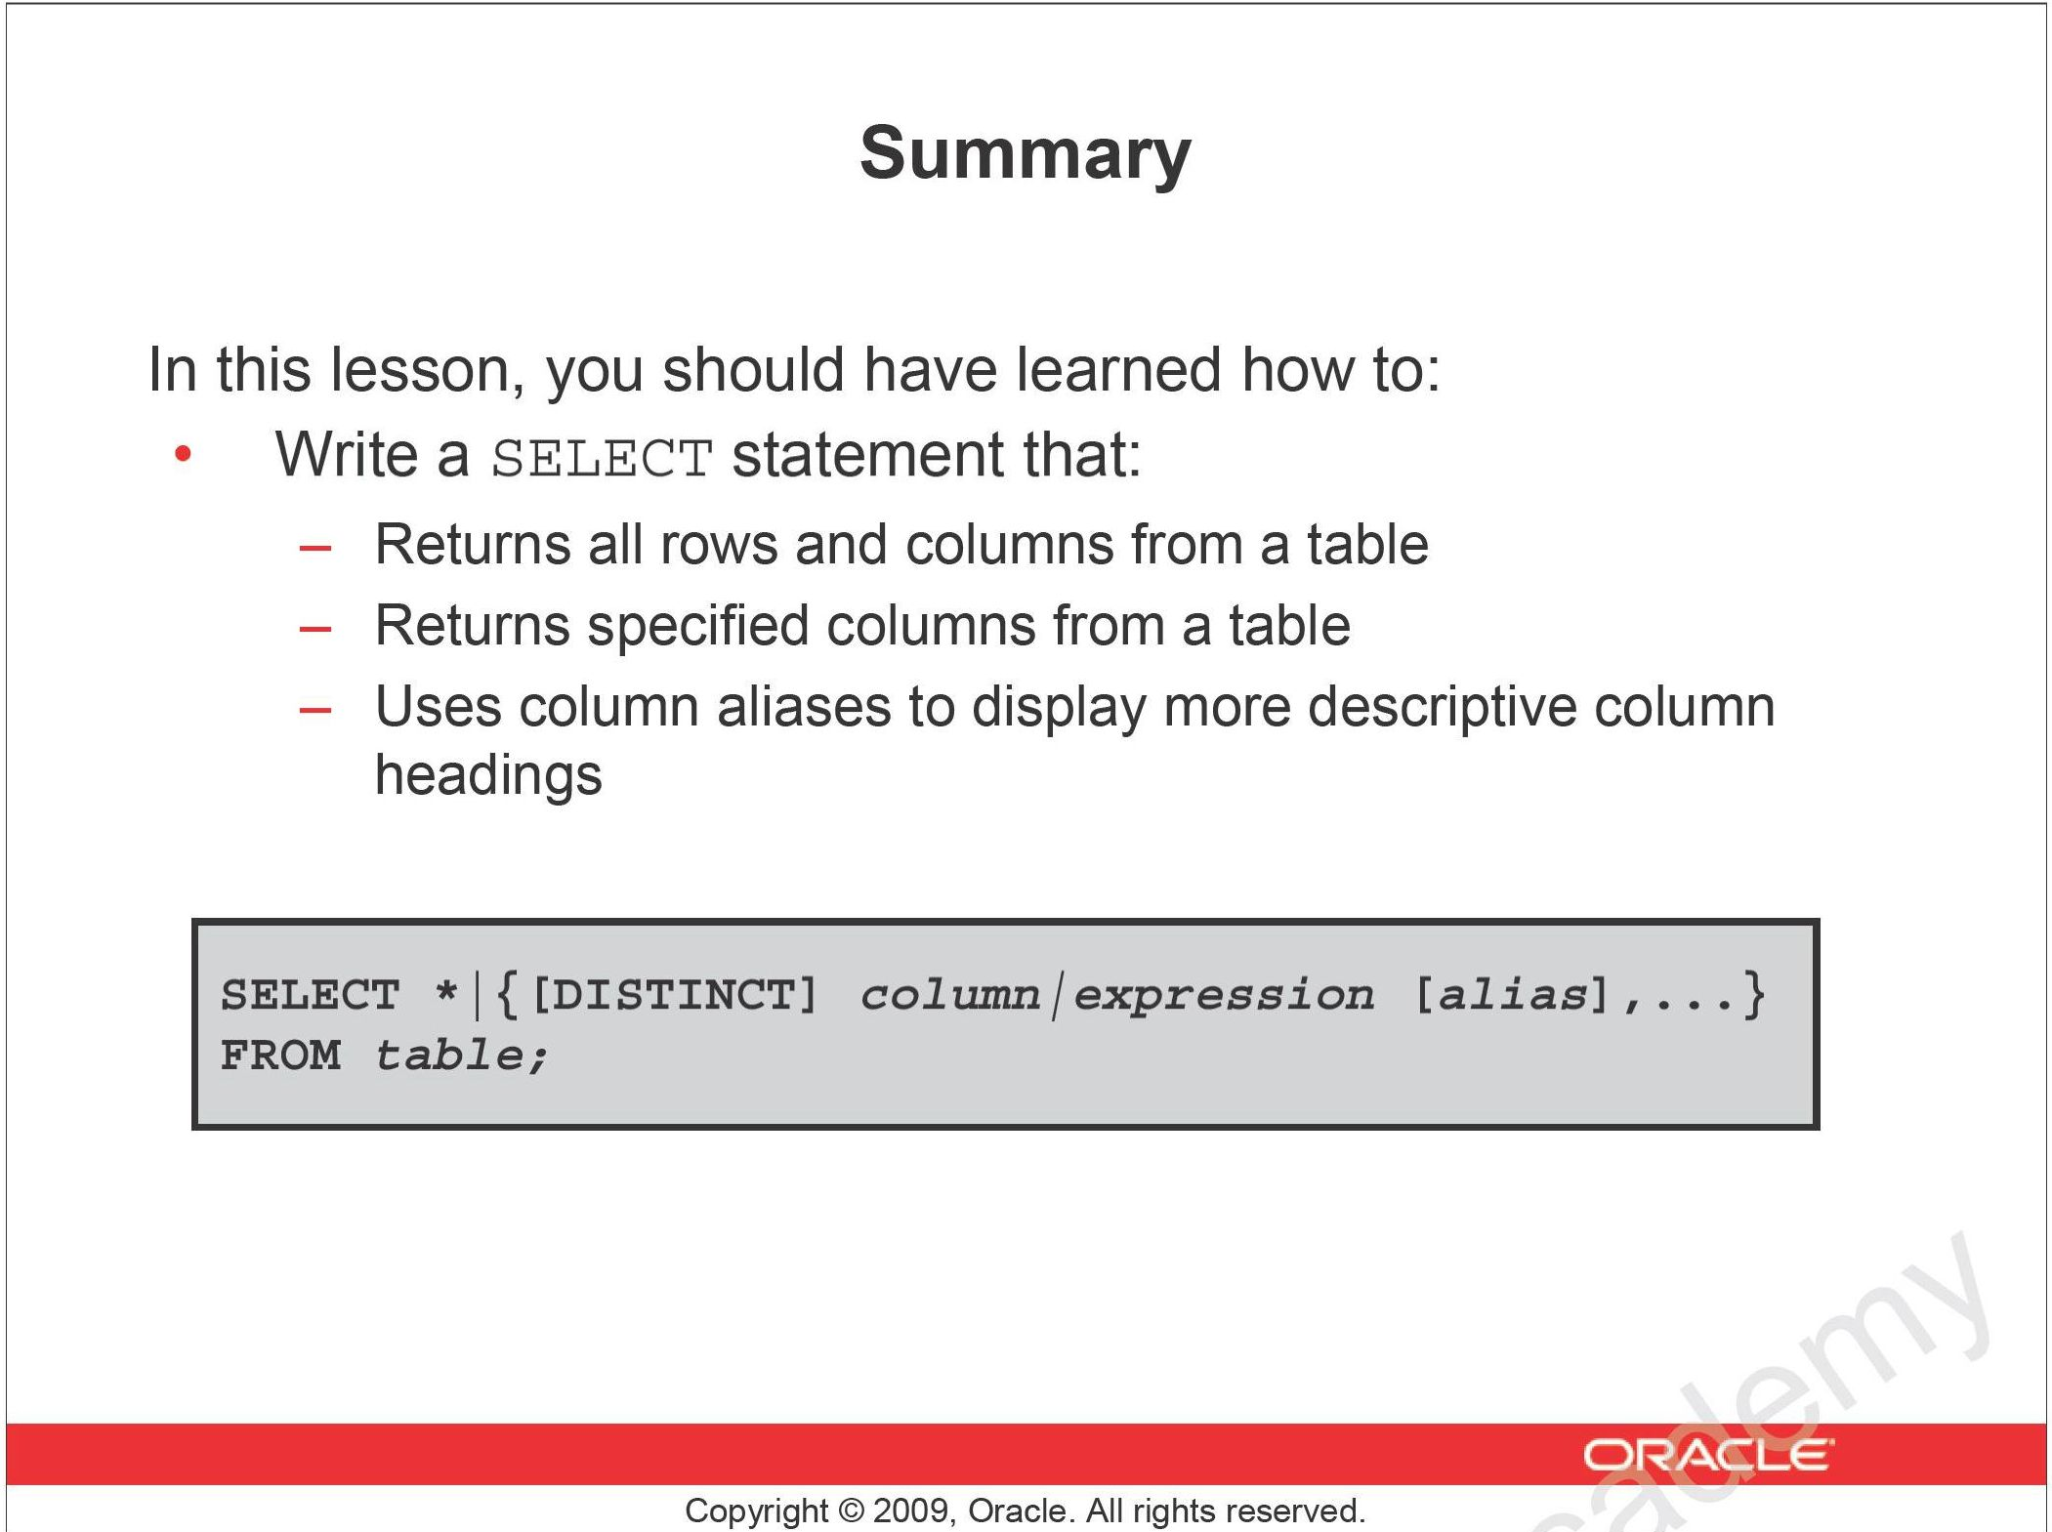

Slide 32
Restricting and Sorting Data

Slide 33
The SQL SELECT Statement
The fundamental framework for an SQL query is the SQL SELECT statement.
SELECT {ColumnName(s)}
FROM {TableName(s)}
WHERE {Condition(s)}
All SQL statements end with a semi-colon (;).

Slide 34
Limiting rows with:
The WHERE clause
The comparison conditions using
=, <=, BETWEEN, IN, LIKE, and NULL conditions
Logical conditions using AND, OR, and NOT operators
Rules of precedence for operators in an expression
Sorting rows using the ORDER BY clause

Slide 35
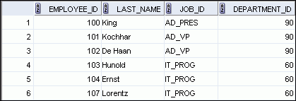

Limiting Rows Using a Selection
EMPLOYEES
…
“retrieve all employees in department 90”
Notes:
Limiting Rows Using a Selection
In the example in the slide, assume that you want to display all the employees in department 90. The rows with a value of 90 in the DEPARTMENT_ID column are the only ones that are returned. This method of restriction is the basis of the WHERE clause in SQL.

Slide 36
Limiting the Rows That Are Selected
Restrict the rows that are returned by using the WHERE clause:
The WHERE clause follows the FROM clause.
SELECT *|{[DISTINCT] column|expression [alias],...}
FROM table
[WHERE condition(s)];
Notes:
Limiting the Rows That Are Selected
You can restrict the rows that are returned from the query by using the WHERE clause. A WHERE clause contains a condition that must be met and it directly follows the FROM clause. If the condition is true, the row meeting the condition is returned.
In the syntax:
WHERE restricts the query to rows that meet a condition
condition is composed of column names, expressions, constants, and a comparison operator. A condition specifies a combination of one or more expressions and logical (Boolean) operators, and returns a value of TRUE, FALSE, or UNKNOWN.
The WHERE clause can compare values in columns, literal, arithmetic expressions, or functions. It consists of three elements:
Column name
Comparison condition
Column name, constant, or list of values

Slide 37

Using the WHERE Clause
SELECT employee_id, last_name, job_id, department_id
FROM employees
WHERE department_id = 90 ;
Notes:
Using the WHERE Clause
In the example, the SELECT statement retrieves the employee ID, last name, job ID, and department number of all employees who are in department 90.
Note: You cannot use column alias in the WHERE clause.

Slide 38
Character Strings and Dates
Character strings and date values are enclosed with single quotation marks.
Character values are case-sensitive and date values are format-sensitive.
The default date display format for ORACLE is DD-MON-YY.
[two-digit DAY, dash, three-character MONTH, dash, two-digit YEAR]
SELECT last_name, job_id, department_id
FROM employees
WHERE last_name = 'Whalen' ;
SELECT last_name
FROM employees
WHERE hire_date = '17-FEB-96' ;
Notes:
Character Strings and Dates
Character strings and dates in the WHERE clause must be enclosed with single quotation marks (''). Number constants, however, should not be enclosed with single quotation marks.
All character searches are case-sensitive. In the following example, no rows are returned because the EMPLOYEES table stores all the last names in mixed case:
SELECT last_name, job_id, department_id
FROM employees
WHERE last_name = 'WHALEN';
Oracle databases store dates in an internal numeric format, representing the century, year, month, day, hours, minutes, and seconds. The default date display is in the DD-MON-RR format.
Note: For details about the RR format and about changing the default date format, see the lesson titled “Using Single-Row Functions to Customize Output.” Also, you learn about the use of single-row functions such as UPPER and LOWER to override the case sensitivity in the same lesson.

Slide 39
Comparison Operators
Operator
Meaning
=
Equal to
>
Greater than
>=
Greater than or equal to
<
Less than
<=
Less than or equal to
<>
Not equal to
BETWEEN ...AND...
Between two values (inclusive)
IN(set)
Match any of a list of values
LIKE
Match a character pattern
IS NULL
Is a null value
Notes:
Comparison Operators
Comparison operators are used in conditions that compare one expression to another value or expression. They are used in the WHERE clause in the following format:
Syntax
... WHERE expr operator value
Example
... WHERE hire_date = '01-JAN-95'
... WHERE salary >= 6000
... WHERE last_name = 'Smith'
An alias cannot be used in the WHERE clause.
Note: The symbols != and ^= can also represent the not equal to condition.

Slide 40

Using Comparison Operators
SELECT last_name, salary
FROM employees
WHERE salary <= 3000 ;
Notes:
Using Comparison Operators
In the example, the SELECT statement retrieves the last name and salary from the EMPLOYEES table for any employee whose salary is less than or equal to $3,000. Note that there is an explicit value supplied to the WHERE clause. The explicit value of 3000 is compared to the salary value in the SALARY column of the EMPLOYEES table.

Slide 41
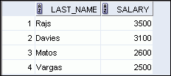
Range Conditions Using the BETWEEN Operator
Use the BETWEEN operator to display rows based on a range of values:
SELECT last_name, salary
FROM employees
WHERE salary BETWEEN 2500 AND 3500 ;
Lower limit
Upper limit
Notes:
Range Conditions Using the BETWEEN Operator
You can display rows based on a range of values using the BETWEEN operator. The range that you specify contains a lower limit and an upper limit.
The SELECT statement in the slide returns rows from the EMPLOYEES table for any employee whose salary is between $2,500 and $3,500.
Values that are specified with the BETWEEN operator are inclusive. However, you must specify the lower limit first.
You can also use the BETWEEN operator on character values:
SELECT last_name FROM employees WHERE last_name BETWEEN 'King' AND 'Smith';

Slide 42
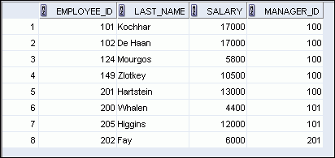
Membership Condition Using the IN Operator
Use the IN operator to test for values in a list:
SELECT employee_id, last_name, salary, manager_id
FROM employees
WHERE manager_id IN (100, 101, 201) ;
Notes:
Membership Condition Using the IN Operator
To test for values in a specified set of values, use the IN operator. The condition defined using the IN operator is also known as the membership condition.
The slide example displays employee numbers, last names, salaries, and managers’ employee numbers for all the employees whose manager’s employee number is 100, 101, or 201.
The IN operator can be used with any data type. The following example returns a row from the EMPLOYEES table, for any employee whose last name is included in the list of names in the WHERE clause:
SELECT employee_id, manager_id, department_id
FROM employees
WHERE last_name IN ('Hartstein', 'Vargas');
If characters or dates are used in the list, they must be enclosed with single quotation marks ('').
Note: The IN operator is internally evaluated by the Oracle server as a set of OR conditions, such as a=value1 or a=value2 or a=value3. Therefore, using the IN operator has no performance benefits and is used only for logical simplicity.

Slide 43
Pattern Matching Using the LIKE Operator
Use the LIKE operator to perform wildcard searches of valid search string values.
Search conditions can contain either literal characters or numbers:
% denotes zero or many characters.
_ denotes one character.
SELECT first_name
FROM employees
WHERE first_name LIKE 'S%' ;
Notes:
Pattern Matching Using the LIKE Operator
You may not always know the exact value to search for. You can select rows that match a character pattern by using the LIKE operator. The character pattern–matching operation is referred to as a wildcard search. Two symbols can be used to construct the search string.
The SELECT statement in the slide returns the first name from the EMPLOYEES table for any employee whose first name begins with the letter “S.” Note the uppercase “S.” Consequently, names beginning with a lowercase “s” are not returned.
The LIKE operator can be used as a shortcut for some BETWEEN comparisons. The following example displays the last names and hire dates of all employees who joined between January, 1995 and December, 1995:
SELECT last_name, hire_date
FROM employees
WHERE hire_date LIKE '%95';

Slide 44

Combining Wildcard Characters
You can combine the two wildcard characters (%, _) with literal characters for pattern matching
SELECT last_name
FROM employees
WHERE last_name LIKE '_o%' ;
Find an employee whose last name has the letter ‘o’ as the second letter.
Notes:
Combining Wildcard Characters
The % and _ symbols can be used in any combination with literal characters. The example in the slide displays the names of all employees whose last names have the letter “o” as the second character.
ESCAPE Identifier
When you need to have an exact match for the actual % and _ characters, use the ESCAPE identifier. This option specifies what the escape character is. If you want to search for strings that contain SA_, you can use the following SQL statement:
SELECT employee_id, last_name, job_id
FROM employees WHERE job_id LIKE '%SA\_%' ESCAPE '\';
The ESCAPE identifier identifies the backslash (\) as the escape character. In the SQL statement, the escape character precedes the underscore (_). This causes the Oracle server to interpret the underscore literally.

Slide 45

Using the NULL Conditions
Test for nulls with the IS NULL operator.
SELECT last_name, manager_id
FROM employees
WHERE manager_id IS NULL ;
You cannot use the ‘=‘ sign to test for NULL
NULL means ‘undefined’, i.e. do not know yet
NULL = NULL will always evaluate to false
Notes:
Using the NULL Conditions
The NULL conditions include the IS NULL condition and the IS NOT NULL condition.
The IS NULL condition tests for nulls. A null value means that the value is unavailable, unassigned, unknown, or inapplicable. Therefore, you cannot test with =, because a null cannot be equal or unequal to any value. The slide example retrieves the last names and managers of all employees who do not have a manager.
Here is another example: To display the last name, job ID, and commission for all employees who are not entitled to receive a commission, use the following SQL statement:
SELECT last_name, job_id, commission_pct
FROM employees
WHERE commission_pct IS NULL;
…

Slide 46
Defining Conditions Using the Logical Operators
Operator
Meaning
AND
Returns TRUE if both component conditions are true
OR
Returns TRUE if either component condition is true
NOT
Returns TRUE if the condition is false
Notes:
Defining Conditions Using the Logical Operators
A logical condition combines the result of two component conditions to produce a single result based on those conditions or it inverts the result of a single condition. A row is returned only if the overall result of the condition is true.
Three logical operators are available in SQL:
AND
OR
NOT
All the examples so far have specified only one condition in the WHERE clause. You can use several conditions in a single WHERE clause using the AND and OR operators.

Slide 47

Using the AND Operator
AND requires both the component conditions to be true:
SELECT employee_id, last_name, job_id, salary
FROM employees
WHERE salary >= 10000 AND
job_id LIKE '%MAN%' ;
Notes:
Using the AND Operator
In the example, both the component conditions must be true for any record to be selected. Therefore, only those employees who have a job title that contains the string ‘MAN’ and earn $10,000 or more are selected.
All character searches are case-sensitive, that is no rows are returned if ‘MAN’ is not uppercase. Further, character strings must be enclosed with quotation marks.
AND Truth Table
The following table shows the results of combining two expressions with AND:

Slide 48
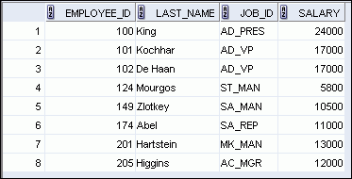
Using the OR Operator
OR requires either component condition to be true:
SELECT employee_id, last_name, job_id, salary
FROM employees
WHERE salary >= 10000 OR
job_id LIKE '%MAN%' ;
Notes:
Using the OR Operator
In the example, either component condition can be true for any record to be selected. Therefore, any employee who has a job ID that contains the string ‘MAN’ or earns $10,000 or more is selected.
OR Truth Table
The following table shows the results of combining two expressions with OR:

Slide 49
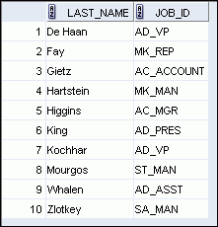
Using the NOT Operator
SELECT last_name, job_id
FROM employees
WHERE job_id
NOT IN ('IT_PROG', 'ST_CLERK', 'SA_REP') ;
Notes:
Using the NOT Operator
The slide example displays the last name and job ID of all employees whose job ID is not IT_PROG, ST_CLERK, or SA_REP.
NOT Truth Table
The following table shows the result of applying the NOT operator to a condition:
Note: The NOT operator can also be used with other SQL operators, such as BETWEEN, LIKE, and NULL.
... WHERE job_id NOT IN ('AC_ACCOUNT', 'AD_VP')
... WHERE salary NOT BETWEEN 10000 AND 15000
... WHERE last_name NOT LIKE '%A%'
... WHERE commission_pct IS NOT NULL

Slide 50
Rules of Precedence
Operator
Meaning
1
Arithmetic operators
2
Concatenation operator
3
Comparison conditions
4
IS [NOT] NULL, LIKE, [NOT] IN
5
[NOT] BETWEEN
6
Not equal to
7
NOT logical condition
8
AND logical condition
9
OR logical condition
You can use parentheses to override rules of precedence.
Notes:
Rules of Precedence
The rules of precedence determine the order in which expressions are evaluated and calculated. The table in the slide lists the default order of precedence. However, you can override the default order by using parentheses around the expressions that you want to calculate first.

Slide 51
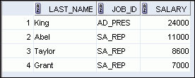

Rules of Precedence
SELECT last_name, job_id, salary
FROM employees
WHERE job_id = 'SA_REP‘ OR
job_id = 'AD_PRES‘ AND
salary > 15000;
1
SELECT last_name, job_id, salary
FROM employees
WHERE (job_id = 'SA_REP‘ OR
job_id = 'AD_PRES') AND
salary > 15000;
2
Notes:
Rules of Precedence (continued)
1. Precedence of the AND Operator: Example
In this example, there are two conditions:
The first condition is that the job ID is AD_PRES and the salary is greater than $15,000.
The second condition is that the job ID is SA_REP.
Therefore, the SELECT statement reads as follows:
“Select the row if an employee is a president and earns more than $15,000, or if the employee is a sales representative.”
2. Using Parentheses: Example
In this example, there are two conditions:
The first condition is that the job ID is AD_PRES or SA_REP.
The second condition is that the salary is greater than $15,000.
Therefore, the SELECT statement reads as follows:
“Select the row if an employee is a president or a sales representative, and if the employee earns more than $15,000.”

Slide 52
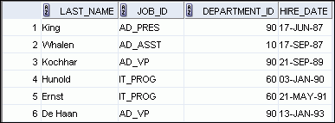
Using the ORDER BY Clause
Sort retrieved rows with the ORDER BY clause:
ASC: Ascending order, default
DESC: Descending order
The ORDER BY clause comes last in the SELECT statement:
SELECT last_name, job_id, department_id, hire_date
FROM employees
ORDER BY hire_date ;
…
Notes:
Using the ORDER BY Clause
The order of rows that are returned in a query result is undefined. The ORDER BY clause can be used to sort the rows. However, if you use the ORDER BY clause, it must be the last clause of the SQL statement. Further, you can specify an expression, an alias, or a column position as the sort condition.
Syntax
SELECT expr
FROM table
[WHERE condition(s)]
[ORDER BY {column, expr, numeric_position} [ASC|DESC]];
In the syntax:
ORDER BY specifies the order in which the retrieved rows are displayed
ASC orders the rows in ascending order (this is the default order)
DESC orders the rows in descending order
If the ORDER BY clause is not used, the sort order is undefined, and the Oracle server may not fetch rows in the same order for the same query twice. Use the ORDER BY clause to display the rows in a specific order.
Note: Use the keywords NULLS FIRST or NULLS LAST to specify whether returned rows containing null values should appear first or last in the ordering sequence.

Slide 53
Sorting
Sorting in descending order:
Sorting by column alias:
SELECT last_name, job_id, department_id, hire_date
FROM employees
ORDER BY hire_date DESC ;
1
SELECT employee_id, last_name, salary*12 annsal
FROM employees
ORDER BY annsal ;
2
Notes:
Sorting
The default sort order is ascending:
Numeric values are displayed with the lowest values first (for example, 1 to 999).
Date values are displayed with the earliest value first (for example, 01-JAN-92 before 01-JAN-95).
Character values are displayed in the alphabetical order (for example, “A” first and “Z” last).
Null values are displayed last for ascending sequences and first for descending sequences.
You can also sort by a column that is not in the SELECT list.
Examples:
1. To reverse the order in which the rows are displayed, specify the DESC keyword after the column name in the ORDER BY clause. The slide example sorts the result by the most recently hired employee.
2. You can also use a column alias in the ORDER BY clause. The slide example sorts the data by annual salary.

Slide 54
Sorting
Sorting by using the column’s numeric position:
SELECT last_name, job_id, department_id, hire_date
FROM employees
ORDER BY 3;
3
Sorting by multiple columns:
SELECT last_name, department_id, salary
FROM employees
ORDER BY department_id, salary DESC;
4
Notes:
Sorting (continued)
Examples:
3. You can sort query results by specifying the numeric position of the column in the SELECT clause. The slide example sorts the result by the department_id as this column is at the third position in the SELECT clause.
4. You can sort query results by more than one column. The sort limit is the number of columns in the given table. In the ORDER BY clause, specify the columns and separate the column names using commas. If you want to reverse the order of a column, specify DESC after its name.

Slide 55
Summary
In this lesson, you should have learned how to:
Use the WHERE clause to restrict rows of output:
Use the comparison conditions
Use the BETWEEN, IN, LIKE, and NULL operators
Apply the logical AND, OR, and NOT operators
Use the ORDER BY clause to sort rows of output:
SELECT *|{[DISTINCT] column|expression [alias],...}
FROM table
[WHERE condition(s)]
[ORDER BY {column, expr, alias} [ASC|DESC]] ;
Notes:
Summary
In this lesson, you should have learned about restricting and sorting rows that are returned by the SELECT statement. You should also have learned how to implement various operators and conditions.
By using the substitution variables, you can add flexibility to your SQL statements. This enables the queries to prompt for the filter condition for the rows during run time.

Slide 56
Displaying Data from Multiple Tables

Slide 57
SELECT Statement
Used for queries on single or multiple tables
Clauses of the SELECT statement:
SELECT
List the columns (and expressions) that should be returned from the query
FROM
Indicate the table(s) or view(s) from which data will be obtained
WHERE
Indicate the conditions under which a row will be included in the result
GROUP BY
Indicate categorization of results
HAVING
Indicate the conditions under which a category (group) will be included
ORDER BY
Sorts the result according to specified criteria
Chapter 6
© 2011 Pearson Education, Inc. Publishing as Prentice Hall

Slide 58
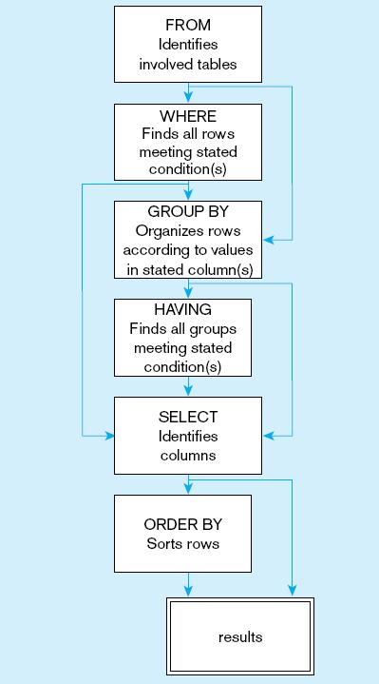
Figure 6-10
SQL statement processing order (adapted from van der Lans, 2006 p.100)
Chapter 6
© 2011 Pearson Education, Inc. Publishing as Prentice Hall

Slide 59

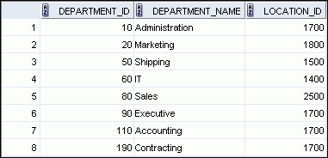

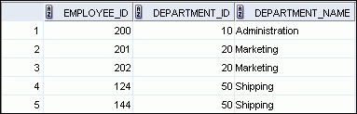

Obtaining Data from Multiple Tables
Query: Display the department id and department name for each employee
EMPLOYEES
DEPARTMENTS
…
…
Notes:
Obtaining Data from Multiple Tables
Sometimes you need to use data from more than one table. In the example in the slide, the report displays data from two separate tables:
Employee IDs exist in the EMPLOYEES table.
Department IDs exist in both the EMPLOYEES and DEPARTMENTS tables.
Department names exist in the DEPARTMENTS table.
To produce the report, you need to link the EMPLOYEES and DEPARTMENTS tables, and access data from both of them.

Slide 60
Obtaining Data from Multiple Tables
Query: Display the department id and department name for each employee
In order to satisfy this query, we need data from TWO tables
EMPLOYEES
DEPARTMENTS
…
The logical steps to process this query would be:
Scan the EMPLOYEES table row by row
For each row, take the EMPLOYEES.DEPARTMENT_ID and match it to the
DEPARTMENTS.DEPARTMENT_ID
When a match is found in the DEPARTMENTS table , extract the DEPARTMENT_NAME

Slide 61
Obtaining Data from Multiple Tables
Query: Display the department id and department name for each employee
To identify each employee, we would need at least the EMPLOYEE_ID.
The DEPARTMENT_ID could be obtained from either the EMPLOYEES table or the DEPARTMENTS table.
The DEPARTMENT_NAME must come from the DEPARTMENTS table.

Slide 62
Obtaining Data from Multiple Tables
Query: Display the department id and department name for each employee
We’ve identified that we need the EMPLOYEES and DEPARTMENTS tables.
FROM EMPLOYEES, DEPARTMENTS
We need to match the EMPLOYEES.DEPARTMENT_ID to the DEPARTMENTS.DEPARTMENT_ID
WHERE EMPLOYEES.Department_ID = DEPARTMENT.department_ID
We will display the EMPLOYEE_ID, DEPARTMENT_ID and DEPARTMENT_NAME
SELECT EMPLOYEES.employee_ID, EMPLOYEES.department_ID,
DEPARTMENTS.department_name
The constructed SQL statement:
SELECT EMPLOYEES.employee_ID, EMPLOYEES.department_ID,
DEPARTMENTS.department_name
FROM EMPLOYEES, DEPARTMENTS
WHERE EMPLOYEES.Department_ID = DEPARTMENT.department_ID;

Slide 63
Obtaining Data from Multiple Tables
The constructed SQL statement:
SELECT EMPLOYEES.employee_ID, EMPLOYEES.department_ID,
DEPARTMENTS.department_name
FROM EMPLOYEES, DEPARTMENTS
WHERE EMPLOYEES.Department_ID = DEPARTMENT.department_ID;
Using table alias to simplify the SQL statement
SELECT E.employee_ID, E.department_ID,
D.department_name
FROM EMPLOYEES E , DEPARTMENTS D
WHERE E.Department_ID = D.department_ID;

Slide 64
Obtaining Data from Multiple Tables
Query: Display some department information including its location city and country
WE need
DEPARTMENTS, LOCATIONS and COUNTRIES TABLE
We choose to display DEPARTMENT_ID, DEPARTMENT_NAME, CITY, COUNTRY_NAME
DEPARTMENT_ID, DEPARTMENT_NAME from DEPRATMENTS table
CITY from LOCATIONS table
COUNTRY_NAME from COUNTRIES table
To link the tables, we need
DEPARTMENTS.LOCATION_ID match to LOCATIONS.LOCATION_ID
LOCATIONS.COUNTRY_ID match to COUNTRIES.COUNTRY_ID

Slide 65
Obtaining Data from Multiple Tables
Query: Display some department information including its location city and country
We’ve identified that we need the DEPARTMENTS, LOCATIONS and COUNTRIES tables.
FROM DEPARTMENTS D, LOCATIONS L, COUNTRIES C
We need to match the DEPARTMENTS.LOCATION_ID to the LOCATIONS.LOCATION_ID
We need to match the LOCATIONS.COUNTRY_ID to the COUNTRIES.COUNTRY_ID
WHERE D.location_ID = L.location_ID and
L.country_ID = C.country_ID
We choose to display DEPARTMENT_ID, DEPARTMENT_NAME, CITY, COUNTRY_NAME
SELECT D.department_ID, D.department_name, L.city,
C.country_name

Slide 66
Obtaining Data from Multiple Tables
Query: Display some department information including its location city and country
The constructed SQL statement:
SELECT D.department_ID, D.department_name, L.city,
C.country_name
FROM DEPARTMENTS D, LOCATIONS L, COUNTRIES C
WHERE D.location_ID = L.location_ID and
L.country_ID = C.country_ID;

Slide 67
Obtaining Data from Multiple Tables
Query: Display employees job history from when he/she was first hired. Include relevant details.
Query: Which region is an employee in currently? Display relevant details.

Slide 68
Reporting Aggregated Data Using the Group Functions

Slide 69
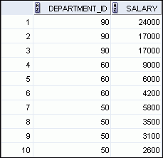


What Are Group Functions?
Group functions operate on sets of rows to give one result per group.
EMPLOYEES
Maximum salary in EMPLOYEES table
…
Notes:
What Are Group Functions?
Unlike single-row functions, group functions operate on sets of rows to give one result per group. These sets may comprise the entire table or the table split into groups.

Slide 70
Types of Group Functions
AVG
COUNT
MAX
MIN
SUM
Group
functions
Notes:
Types of Group Functions
Each of the functions accepts an argument. The following table identifies the options that you can use in the syntax:

Slide 71
Group Functions: Syntax
SELECT group_function(column), ...
FROM table
[WHERE condition]
[ORDER BY column];
Notes:
Group Functions: Syntax
The group function is placed after the SELECT keyword. You may have multiple group functions separated by commas.
Guidelines for using the group functions:
DISTINCT makes the function consider only nonduplicate values; ALL makes it consider every value, including duplicates. The default is ALL and therefore does not need to be specified.
The data types for the functions with an expr argument may be CHAR, VARCHAR2, NUMBER, or DATE.
All group functions ignore null values. To substitute a value for null values, use the NVL, NVL2, or COALESCE functions.

Slide 72

Using the AVG and SUM Functions
You can use AVG and SUM for numeric data.
SELECT AVG(salary), MAX(salary),
MIN(salary), SUM(salary)
FROM employees
WHERE job_id LIKE '%REP%';
Notes:
Using the AVG and SUM Functions
You can use the AVG, SUM, MIN, and MAX functions against the columns that can store numeric data. The example in the slide displays the average, highest, lowest, and sum of monthly salaries for all sales representatives.

Slide 73

Using the MIN and MAX Functions
You can use MIN and MAX for numeric, character, and date data types.
SELECT MIN(hire_date), MAX(hire_date)
FROM employees;
Notes:
Using the MIN and MAX Functions
You can use the MAX and MIN functions for numeric, character, and date data types. The example in the slide displays the most junior and most senior employees.
The following example displays the employee last name that is first and the employee last name that is last in an alphabetic list of all employees:
SELECT MIN(last_name), MAX(last_name)
FROM employees;
Note: The AVG, SUM, VARIANCE, and STDDEV functions can be used only with numeric data types. MAX and MIN cannot be used with LOB or LONG data types.

Slide 74


Using the COUNT Function
COUNT(*) returns the number of rows in a table:
COUNT(expr) returns the number of rows with non-null values for expr:
SELECT COUNT(*)
FROM employees
WHERE department_id = 50;
1
SELECT COUNT(commission_pct)
FROM employees
WHERE department_id = 80;
2
Notes:
Using the COUNT Function
The COUNT function has three formats:
COUNT(*)
COUNT(expr)
COUNT(DISTINCT expr)
COUNT(*) returns the number of rows in a table that satisfy the criteria of the SELECT statement, including duplicate rows and rows containing null values in any of the columns. If a WHERE clause is included in the SELECT statement, COUNT(*) returns the number of rows that satisfy the condition in the WHERE clause.
In contrast, COUNT(expr) returns the number of non-null values that are in the column identified by expr.
COUNT(DISTINCT expr) returns the number of unique, non-null values that are in the column identified by expr.
Examples:
1. The example in the slide displays the number of employees in department 50.
2. The example in the slide displays the number of employees in department 80 who can earn a commission.

Slide 75

Using the DISTINCT Keyword
COUNT(DISTINCT expr) returns the number of distinct non-null values of expr.
To display the number of distinct department values in the EMPLOYEES table:
SELECT COUNT(DISTINCT department_id)
FROM employees;
Notes:
Using the DISTINCT Keyword
Use the DISTINCT keyword to suppress the counting of any duplicate values in a column.
The example in the slide displays the number of distinct department values that are in the EMPLOYEES table.

Slide 76


Group Functions and Null Values
Group functions ignore null values in the column:
The NVL function forces group functions to include null values:
SELECT AVG(commission_pct)
FROM employees;
1
SELECT AVG(NVL(commission_pct, 0))
FROM employees;
2
Notes:
Group Functions and Null Values
All group functions ignore null values in the column.
However, the NVL function forces group functions to include null values.
Examples:
1. The average is calculated based on only those rows in the table in which a valid value is stored in the COMMISSION_PCT column. The average is calculated as the total commission that is paid to all employees divided by the number of employees receiving a commission (four).
2. The average is calculated based on all rows in the table, regardless of whether null values are stored in the COMMISSION_PCT column. The average is calculated as the total commission that is paid to all employees divided by the total number of employees in the company (20).

Slide 77
Group functions:
Types and syntax
Use AVG, SUM, MIN, MAX, COUNT
Use DISTINCT keyword within group functions
NULL values in a group function
Grouping rows:
GROUP BY clause
HAVING clause
Nesting group functions

Slide 78
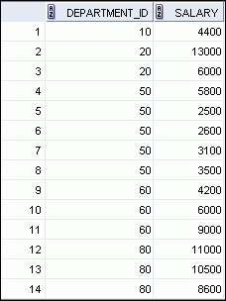
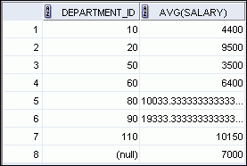

Creating Groups of Data
EMPLOYEES
Average salary in
EMPLOYEES table for
each department
4400
9500
3500
6400
10033
…
Notes:
Creating Groups of Data
Until this point in our discussion, all group functions have treated the table as one large group of information. At times, however, you need to divide the table of information into smaller groups. This can be done by using the GROUP BY clause.

Slide 79
Creating Groups of Data: GROUP BY Clause Syntax
You can divide rows in a table into smaller groups by using the GROUP BY clause.
SELECT column, group_function(column)
FROM table
[WHERE condition]
[GROUP BY group_by_expression]
[ORDER BY column];
Notes:
Creating Groups of Data: GROUP BY Clause Syntax
You can use the GROUP BY clause to divide the rows in a table into groups. You can then use the group functions to return summary information for each group.
In the syntax:
group_by_expression specifies columns whose values determine the basis for grouping rows
Guidelines
If you include a group function in a SELECT clause, you cannot select individual results as well, unless the individual column appears in the GROUP BY clause. You receive an error message if you fail to include the column list in the GROUP BY clause.
Using a WHERE clause, you can exclude rows before dividing them into groups.
You must include the columns in the GROUP BY clause.
You cannot use a column alias in the GROUP BY clause.

Slide 80
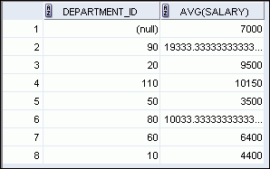
Using the GROUP BY Clause
All columns in the SELECT list that are not in group functions must be in the GROUP BY clause.
SELECT department_id, AVG(salary)
FROM employees
GROUP BY department_id ;
Notes:
Using the GROUP BY Clause
When using the GROUP BY clause, make sure that all columns in the SELECT list that are not group functions are included in the GROUP BY clause. The example in the slide displays the department number and the average salary for each department. Here is how this SELECT statement, containing a GROUP BY clause, is evaluated:
The SELECT clause specifies the columns to be retrieved, as follows:
Department number column in the EMPLOYEES table
The average of all salaries in the group that you specified in the GROUP BY clause
The FROM clause specifies the tables that the database must access: the EMPLOYEES table
The WHERE clause specifies the rows to be retrieved. Because there is no WHERE clause, all rows are retrieved by default.
The GROUP BY clause specifies how the rows should be grouped. The rows are grouped by department number, so the AVG function that is applied to the salary column calculates the average salary for each department.

Slide 81
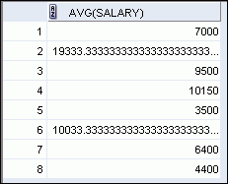
Using the GROUP BY Clause
The GROUP BY column does not have to be in the SELECT list.
SELECT AVG(salary)
FROM employees
GROUP BY department_id ;
Notes:
Using the GROUP BY Clause (continued)
The GROUP BY column does not have to be in the SELECT clause. For example, the SELECT statement in the slide displays the average salaries for each department without displaying the respective department numbers. Without the department numbers, however, the results do not look meaningful.
You can also use the group function in the ORDER BY clause:
SELECT department_id, AVG(salary)
FROM employees
GROUP BY department_id
ORDER BY AVG(salary);
…

Slide 82
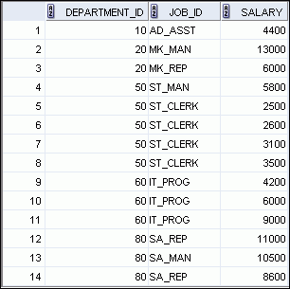
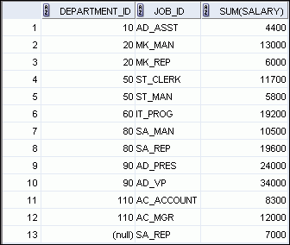

Grouping by More than One Column
EMPLOYEES
Add the salaries in the EMPLOYEES
table for each job, grouped by department.
…
Notes:
Grouping by More than One Column
Sometimes, you need to see results for groups within groups. The slide shows a report that displays the total salary that is paid to each job title in each department.
The EMPLOYEES table is grouped first by the department number, and then by the job title within that grouping. For example, the four stock clerks in department 50 are grouped together, and a single result (total salary) is produced for all stock clerks in the group.
The following SELECT statement returns the result shown in the slide:
SELECT department_id, job_id, sum(salary)
FROM employees
GROUP BY department_id, job_id
ORDER BY job_id;

Slide 83
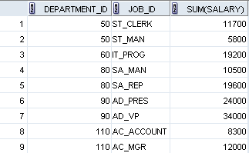
Using the GROUP BY Clause on Multiple Columns
SELECT department_id, job_id, SUM(salary)
FROM employees
WHERE department_id > 40
GROUP BY department_id, job_id
ORDER BY department_id;
Notes:
Using the Group By Clause on Multiple Columns
You can return summary results for groups and subgroups by listing multiple GROUP BY columns. The GROUP BY clause groups rows but does not guarantee the order of the result set. To order the groupings, use the ORDER BY clause.
In the example in the slide, the SELECT statement that contains a GROUP BY clause is evaluated as follows:
The SELECT clause specifies the column to be retrieved:
Department ID in the EMPLOYEES table
Job ID in the EMPLOYEES table
The sum of all salaries in the group that you specified in the GROUP BY clause
The FROM clause specifies the tables that the database must access: the EMPLOYEES table.
The WHERE clause reduces the result set to those rows where department ID is greater than 40.
The GROUP BY clause specifies how you must group the resulting rows:
First, the rows are grouped by the department ID.
Second, the rows are grouped by job ID in the department ID groups.
The ORDER BY clause sorts the results by department ID.
Notes: The SUM function is applied to the salary column for all job IDs in the result set in each department ID group. Also, note that the SA_REP row is not returned. The department ID for this row is NULL, and therefore, does not meet the WHERE condition.

Slide 84


Illegal Queries Using Group Functions
Any column or expression in the SELECT list that is not an aggregate function must be in the GROUP BY clause:
SELECT department_id, COUNT(last_name)
FROM employees;
A GROUP BY clause must be added to count the last names for each department_id.
SELECT department_id, job_id, COUNT(last_name)
FROM employees
GROUP BY department_id;
Either add job_id in the GROUP BY or remove the job_id column from the SELECT list.
Notes:
Illegal Queries Using Group Functions
Whenever you use a mixture of individual items (DEPARTMENT_ID) and group functions (COUNT) in the same SELECT statement, you must include a GROUP BY clause that specifies the individual items (in this case, DEPARTMENT_ID). If the GROUP BY clause is missing, then the error message “not a single-group group function” appears and an asterisk (*) points to the offending column. You can correct the error in the first example in the slide by adding the GROUP BY clause:
SELECT department_id, count(last_name)
FROM employees
GROUP BY department_id;
Any column or expression in the SELECT list that is not an aggregate function must be in the GROUP BY clause. In the second example in the slide, job_id is neither in the GROUP BY clause nor is it being used by a group function, so there is a “not a GROUP BY expression” error. You can correct the error in the second slide example by adding job_id in the GROUP BY clause.
SELECT department_id, job_id, COUNT(last_name)
FROM employees
GROUP BY department_id, job_id;

Slide 85
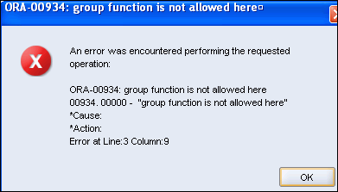
Illegal Queries Using Group Functions
You cannot use the WHERE clause to restrict groups.
You use the HAVING clause to restrict groups.
You cannot use group functions in the WHERE clause.
SELECT department_id, AVG(salary)
FROM employees
WHERE AVG(salary) > 8000
GROUP BY department_id;
Cannot use the WHERE clause to restrict groups
Notes:
Illegal Queries Using Group Functions (continued)
The WHERE clause cannot be used to restrict groups. The SELECT statement in the example in the slide results in an error because it uses the WHERE clause to restrict the display of the average salaries of those departments that have an average salary greater than $8,000.
However, you can correct the error in the example by using the HAVING clause to restrict groups:
SELECT department_id, AVG(salary)
FROM employees
GROUP BY department_id
HAVING AVG(salary) > 8000;

Slide 86
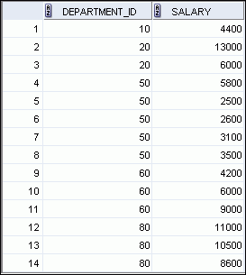
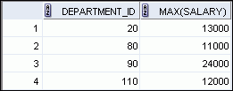

Restricting Group Results
EMPLOYEES
The maximum salary per department when it is
greater than $10,000
…
Notes:
Restricting Group Results
You use the HAVING clause to restrict groups in the same way that you use the WHERE clause to restrict the rows that you select. To find the maximum salary in each of the departments that have a maximum salary greater than $10,000, you need to do the following:
1. Find the average salary for each department by grouping by department number.
2. Restrict the groups to those departments with a maximum salary greater than $10,000.

Slide 87
Restricting Group Results with the HAVING Clause
When you use the HAVING clause, the Oracle server restricts groups as follows:
1. Rows are grouped.
2. The group function is applied.
3. Groups matching the HAVING clause are displayed.
SELECT column, group_function
FROM table
[WHERE condition]
[GROUP BY group_by_expression]
[HAVING group_condition]
[ORDER BY column];
Notes:
Restricting Group Results with the HAVING Clause
You use the HAVING clause to specify the groups that are to be displayed, thus further restricting the groups on the basis of aggregate information.
In the syntax, group_condition restricts the groups of rows returned to those groups for which the specified condition is true.
The Oracle server performs the following steps when you use the HAVING clause:
1. Rows are grouped.
2. The group function is applied to the group.
3. The groups that match the criteria in the HAVING clause are displayed.
The HAVING clause can precede the GROUP BY clause, but it is recommended that you place the GROUP BY clause first because it is more logical. Groups are formed and group functions are calculated before the HAVING clause is applied to the groups in the SELECT list.

Slide 88
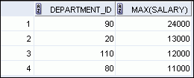
Using the HAVING Clause
SELECT department_id, MAX(salary)
FROM employees
GROUP BY department_id
HAVING MAX(salary)>10000 ;
Notes:
Using the HAVING Clause
The example in the slide displays the department numbers and maximum salaries for those departments with a maximum salary greater than $10,000.
You can use the GROUP BY clause without using a group function in the SELECT list. If you restrict rows based on the result of a group function, you must have a GROUP BY clause as well as the HAVING clause.
The following example displays the department numbers and average salaries for those departments with a maximum salary greater than $10,000:
SELECT department_id, AVG(salary)
FROM employees
GROUP BY department_id
HAVING max(salary)>10000;

Slide 89

Using the HAVING Clause
SELECT job_id, SUM(salary) PAYROLL
FROM employees
WHERE job_id NOT LIKE '%REP%'
GROUP BY job_id
HAVING SUM(salary) > 13000
ORDER BY SUM(salary);
Notes:
Using the HAVING Clause (continued)
The example in the slide displays the job ID and total monthly salary for each job that has a total payroll exceeding $13,000. The example excludes sales representatives and sorts the list by the total monthly salary.

Slide 90

Nesting Group Functions
Display the maximum average salary:
SELECT MAX(AVG(salary))
FROM employees
GROUP BY department_id;
Notes:
Nesting Group Functions
Group functions can be nested to a depth of two functions. The example in the slide calculates the average salary for each department_id and then displays the maximum average salary.
Note that GROUP BY clause is mandatory when nesting group functions.

Slide 91
Summary
In this lesson, you should have learned how to:
Use the group functions COUNT, MAX, MIN, SUM, and AVG
Write queries that use the GROUP BY clause
Write queries that use the HAVING clause
SELECT column, group_function
FROM table
[WHERE condition]
[GROUP BY group_by_expression]
[HAVING group_condition]
[ORDER BY column];
Notes:
Summary
There are several group functions available in SQL, such as:
AVG, COUNT, MAX, MIN, SUM, STDDEV, and VARIANCE
You can create subgroups by using the GROUP BY clause. Further, groups can be restricted using the HAVING clause.
Place the HAVING and GROUP BY clauses after the WHERE clause in a statement. The order of the GROUP BY and HAVING clauses following the WHERE clause is not important. Place the ORDER BY clause at the end.
The Oracle server evaluates the clauses in the following order:
1. If the statement contains a WHERE clause, the server establishes the candidate rows.
2. The server identifies the groups that are specified in the GROUP BY clause.
3. The HAVING clause further restricts result groups that do not meet the group criteria in the HAVING clause.
Note: For a complete list of the group functions, see Oracle Database SQL Language Reference 11g, Release 1 (11.1).

Slide 92
Manipulating Data
(HOMEWORK)

Slide 93
Adding new rows in a table
INSERT statement
Changing data in a table
UPDATE statement
Removing rows from a table:
DELETE statement

Slide 94
Data Manipulation Language
A DML statement is executed when you:
Add new rows to a table
Modify existing rows in a table
Remove existing rows from a table
A transaction consists of a collection of DML statements that form a logical unit of work.
Notes:
Data Manipulation Language
Data manipulation language (DML) is a core part of SQL. When you want to add, update, or delete data in the database, you execute a DML statement. A collection of DML statements that form a logical unit of work is called a transaction.
Consider a banking database. When a bank customer transfers money from a savings account to a checking account, the transaction might consist of three separate operations: decreasing the savings account, increasing the checking account, and recording the transaction in the transaction journal. The Oracle server must guarantee that all the three SQL statements are performed to maintain the accounts in proper balance. When something prevents one of the statements in the transaction from executing, the other statements of the transaction must be undone.
Note
Most of the DML statements in this lesson assume that no constraints on the table are violated. Constraints are discussed later in this course.
In SQL Developer, click the Run Script icon or press [F5] to run the DML statements. The feedback messages will be shown on the Script Output tabbed page.

Slide 95
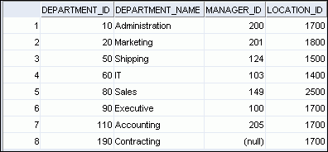
Adding a New Row to a Table
New
row
DEPARTMENTS
Insert new row into the DEPARTMENTS table.
Notes:
Adding a New Row to a Table
The graphic in the slide illustrates the addition of a new department to the DEPARTMENTS table.

Slide 96
INSERT Statement Syntax
Add new rows to a table by using the INSERT statement:
With this syntax, only one row is inserted at a time.
INSERT INTO table [(column [, column...])]
VALUES (value [, value...]);
Notes:
INSERT Statement Syntax
You can add new rows to a table by issuing the INSERT statement.
In the syntax:
table is the name of the table
column is the name of the column in the table to populate
value is the corresponding value for the column
Note: This statement with the VALUES clause adds only one row at a time to a table.

Slide 97
Inserting New Rows
Insert a new row containing values for each column.
List values in the default order of the columns in the table.
Optionally, list the columns in the INSERT clause.
Enclose character and date values within single quotation marks.
INSERT INTO departments(department_id,
department_name, manager_id, location_id)
VALUES (70, 'Public Relations', 100, 1700);
Notes:
Inserting New Rows
Because you can insert a new row that contains values for each column, the column list is not required in the INSERT clause. However, if you do not use the column list, the values must be listed according to the default order of the columns in the table, and a value must be provided for each column.
DESCRIBE departments
For clarity, use the column list in the INSERT clause. Enclose character and date values within single quotation marks; however, it is not recommended that you enclose numeric values within single quotation marks.

Slide 98
Inserting Rows with Null Values
Implicit method: Omit the column from the column list.
Explicit method: Specify the NULL keyword in the VALUES clause.
INSERT INTO departments (department_id,
department_name)
VALUES (30, 'Purchasing');
INSERT INTO departments
VALUES (100, 'Finance', NULL, NULL);
Notes:
Inserting Rows with Null Values
Be sure that you can use null values in the targeted column by verifying the Null status with the DESCRIBE command.
The Oracle server automatically enforces all data types, data ranges, and data integrity constraints. Any column that is not listed explicitly obtains a null value in the new row.
Common errors that can occur during user input are checked in the following order:
Mandatory value missing for a NOT NULL column
Duplicate value violating any unique or primary key constraint
Any value violating a CHECK constraint
Referential integrity maintained for foreign key constraint
Data type mismatches or values too wide to fit in column
Note: Use of the column list is recommended as it makes the INSERT statement more readable and reliable, or less prone to mistakes.

Slide 99
Inserting Special Values
The SYSDATE function records the current date and time.
INSERT INTO employees (employee_id,
first_name, last_name,
email, phone_number,
hire_date, job_id, salary,
commission_pct, manager_id,
department_id)
VALUES (113,
'Louis', 'Popp',
'LPOPP', '515.124.4567',
SYSDATE, 'AC_ACCOUNT', 6900,
NULL, 205, 110);
Notes:
Inserting Special Values
You can use functions to enter special values in your table.
The slide example records information for employee Popp in the EMPLOYEES table. It supplies the current date and time in the HIRE_DATE column. It uses the SYSDATE function that returns the current date and time of the database server. You may also use the CURRENT_DATE function to get the current date in the session time zone. You can also use the USER function when inserting rows in a table. The USER function records the current username.
Confirming Additions to the Table
SELECT employee_id, last_name, job_id, hire_date, commission_pct
FROM employees
WHERE employee_id = 113;

Slide 100
Inserting Specific Date and Time Values
Add a new employee.
INSERT INTO employees
VALUES (114,
'Den', 'Raphealy',
'DRAPHEAL', '515.127.4561',
TO_DATE('FEB 3, 1999', 'MON DD, YYYY'),
'SA_REP', 11000, 0.2, 100, 60);
Notes:
Inserting Specific Date and Time Values
The DD-MON-RR format is generally used to insert a date value. With the RR format, the system provides the correct century automatically.
You may also supply the date value in the DD-MON-YYYY format. This is recommended because it clearly specifies the century and does not depend on the internal RR format logic of specifying the correct century.
If a date must be entered in a format other than the default format (for example, with another century or a specific time), you must use the TO_DATE function.
The example in the slide records information for employee Raphealy in the EMPLOYEES table. It sets the HIRE_DATE column to be February 3, 1999.

Slide 101
Copying Rows from Another Table
Write your INSERT statement with a subquery:
Do not use the VALUES clause.
Match the number of columns in the INSERT clause to those in the subquery.
Inserts all the rows returned by the subquery in the table, sales_reps.
INSERT INTO sales_reps(id, name, salary, commission_pct)
SELECT employee_id, last_name, salary, commission_pct
FROM employees
WHERE job_id LIKE '%REP%';
Notes:
Copying Rows from Another Table
You can use the INSERT statement to add rows to a table where the values are derived from existing tables. In the slide example, for the INSERT INTO statement to work, you must have already created the sales_reps table using the CREATE TABLE statement. CREATE TABLE is discussed in the next lesson titled “Using DDL Statements to Create and Manage Tables.”
In place of the VALUES clause, you use a subquery.
Syntax
INSERT INTO table [ column (, column) ] subquery;
In the syntax:
table is the name of the table
column is the name of the column in the table to populate
subquery is the subquery that returns rows to the table
The number of columns and their data types in the column list of the INSERT clause must match the number of values and their data types in the subquery. Zero or more rows are added depending on the number of rows returned by the subquery. To create a copy of the rows of a table, use SELECT * in the subquery:
INSERT INTO copy_emp
SELECT *
FROM employees;

Slide 102
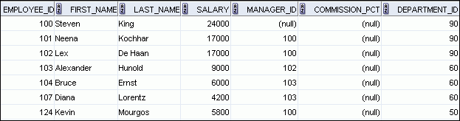

Changing Data in a Table
EMPLOYEES
Update rows in the EMPLOYEES table:
Notes:
Changing Data in a Table
The slide illustrates changing the department number for employees in department 60 to department 80.

Slide 103
UPDATE Statement Syntax
Modify existing values in a table with the UPDATE statement:
Update more than one row at a time (if required).
UPDATE table
SET column = value [, column = value, ...]
[WHERE condition];
Notes:
UPDATE Statement Syntax
You can modify the existing values in a table by using the UPDATE statement.
In the syntax:
table is the name of the table
column is the name of the column in the table to populate
value is the corresponding value or subquery for the column
condition identifies the rows to be updated and is composed of column names, expressions, constants, subqueries, and comparison operators
Confirm the update operation by querying the table to display the updated rows.
For more information, see the section on “UPDATE” in the Oracle Database SQL Language Reference 11g, Release 1 (11.1).
Note: In general, use the primary key column in the WHERE clause to identify a single row for update. Using other columns can unexpectedly cause several rows to be updated. For example, identifying a single row in the EMPLOYEES table by name is dangerous, because more than one employee may have the same name.

Slide 104
Updating Rows in a Table
Values for a specific row or rows are modified if you specify the WHERE clause:
Values for all the rows in the table are modified if you omit the WHERE clause:
Specify SET column_name= NULL to update a column value to NULL.
UPDATE employees
SET department_id = 50
WHERE employee_id = 113;
UPDATE copy_emp
SET department_id = 110;
Notes:
Updating Rows in a Table
The UPDATE statement modifies the values of a specific row or rows if the WHERE clause is specified. The example in the slide shows the transfer of employee 113 (Popp) to department 50.
If you omit the WHERE clause, values for all the rows in the table are modified. Examine the updated rows in the COPY_EMP table.
SELECT last_name, department_id
FROM copy_emp;
For example, an employee who was a SA_REP has now changed his job to an IT_PROG. Therefore, his JOB_ID needs to be updated and the commission field needs to be set to NULL.
UPDATE employees
SET job_id = ‘IT_PROG’, commission_pct = NULL
WHERE employee_id = 114;
Note: The COPY_EMP table has the same data as the EMPLOYEES table.
…

Slide 105
Updating Two Columns with a Subquery
Update employee 113’s job and salary to match those of employee 205.
UPDATE employees
SET job_id = (SELECT job_id
FROM employees
WHERE employee_id = 205),
salary = (SELECT salary
FROM employees
WHERE employee_id = 205)
WHERE employee_id = 113;
Notes:
Updating Two Columns with a Subquery
You can update multiple columns in the SET clause of an UPDATE statement by writing multiple subqueries. The syntax is as follows:
UPDATE table
SET column =
(SELECT column
FROM table
WHERE condition)
[ ,
column =
(SELECT column
FROM table
WHERE condition)]
[WHERE condition ] ;
The example in the slide can also be written as follows:
UPDATE employees
SET (job_id, salary) = (SELECT job_id, salary
FROM employees
WHERE employee_id = 205)
WHERE employee_id = 113;

Slide 106
Updating Rows Based on Another Table
Use the subqueries in the UPDATE statements to update row values in a table based on values from another table:
UPDATE copy_emp
SET department_id = (SELECT department_id
FROM employees
WHERE employee_id = 100)
WHERE job_id = (SELECT job_id
FROM employees
WHERE employee_id = 200);
Notes:
Updating Rows Based on Another Table
You can use the subqueries in the UPDATE statements to update values in a table. The example in the slide updates the COPY_EMP table based on the values from the EMPLOYEES table. It changes the department number of all employees with employee 200’s job ID to employee 100’s current department number.

Slide 107
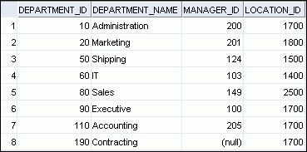
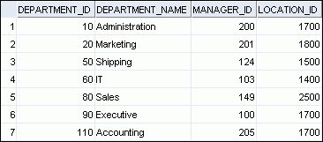
Removing a Row from a Table
DEPARTMENTS
Delete a row from the DEPARTMENTS table:
Notes:
Removing a Row from a Table
The Contracting department has been removed from the DEPARTMENTS table (assuming no constraints on the DEPARTMENTS table are violated), as shown by the graphic in the slide.

Slide 108
DELETE Statement
You can remove existing rows from a table by using the DELETE statement:
DELETE [FROM] table
[WHERE condition];
Notes:
DELETE Statement Syntax
You can remove existing rows from a table by using the DELETE statement.
In the syntax:
table is the name of the table
condition identifies the rows to be deleted, and is composed of column names, expressions, constants, subqueries, and comparison operators
Note: If no rows are deleted, the message “0 rows deleted” is returned (in the Script Output tab in SQL Developer)
For more information, see the section on “DELETE” in Oracle Database SQL Language Reference 11g, Release 1 (11.1).

Slide 109
Deleting Rows from a Table
Specific rows are deleted if you specify the WHERE clause:
All rows in the table are deleted if you omit the WHERE clause:
DELETE FROM departments
WHERE department_name = ‘Finance';
DELETE FROM copy_emp;
Notes:
Deleting Rows from a Table
You can delete specific rows by specifying the WHERE clause in the DELETE statement. The first example in the slide deletes the Accounting department from the DEPARTMENTS table. You can confirm the delete operation by displaying the deleted rows using the SELECT statement.
SELECT *
FROM departments
WHERE department_name = ‘Finance';
However, if you omit the WHERE clause, all rows in the table are deleted. The second example in the slide deletes all rows from the COPY_EMP table, because no WHERE clause was specified.
Example:
Remove rows identified in the WHERE clause.
DELETE FROM employees WHERE employee_id = 114;
DELETE FROM departments WHERE department_id IN (30, 40);

Slide 110
Deleting Rows Based on Another Table
Use the subqueries in the DELETE statements to remove rows from a table based on values from another table:
DELETE FROM employees
WHERE department_id =
(SELECT department_id
FROM departments
WHERE department_name
LIKE '%Public%');
Remove employees from departments that has the word ‘Public’ in their name
Notes:
Deleting Rows Based on Another Table
You can use the subqueries to delete rows from a table based on values from another table. The example in the slide deletes all the employees in a department, where the department name contains the string Public.
The subquery searches the DEPARTMENTS table to find the department number based on the department name containing the string Public. The subquery then feeds the department number to the main query, which deletes rows of data from the EMPLOYEES table based on this department number.

Slide 111
Summary
In this lesson, you should have learned how to use the following statements:
Function
Description
INSERT
Adds a new row to the table
UPDATE
Modifies existing rows in the table
DELETE
Removes existing rows from the table
Notes:
Summary
In this lesson, you should have learned how to manipulate data in the Oracle database by using the INSERT, UPDATE, DELETE, and TRUNCATE statements, as well as how to control data changes by using the COMMIT, SAVEPOINT, and ROLLBACK statements. You also learned how to use the FOR UPDATE clause of the SELECT statement to lock rows for your changes only.
Remember that the Oracle server guarantees a consistent view of data at all times.

